Slide 1
TABLEAU Use case Study
On Electric Vehicle Data Analysis

Slide 2
PROBLEM STATEMENT
KPI’S Requirement
Total Vehicles:
Understand the overall landscape of electric vehicles, encompassing both BEVs and PHEVs, to assess the market's size and growth.
2. Average Electric Range:
Determine the average electric range of the electric vehicles in the dataset to gauge the technological advancements and efficiency of the EVs.
3. Total BEV Vehicles and % of Total BEV Vehicles:
Identify and analyze the total number of Battery Electric Vehicles (BEVs) in the dataset.
Calculate the percentage of BEVs relative to the total number of electric vehicles, providing insights into the dominance of fully electric models.
4. Total PHEV Vehicles and % of Total PHEV Vehicles:
Identify and analyze the total number of Plug-in Hybrid Electric Vehicles (PHEVs) in the dataset.
Calculate the percentage of PHEVs relative to the total number of electric vehicles, offering insights into the market share of plug-in hybrid models.

Slide 3
PROBLEM STATEMENT
Charts Requirement
Total Vehicles by Model Year (From 2010 Onwards):
Visualization: Line/ Area Chart
Description: This chart will illustrate the distribution of electric vehicles over the years, starting from 2010, providing insights into the growth pattern and adoption trends.
2. Total Vehicles by State:
Visualization: Map Chart
Description: This chart will showcase the geographical distribution of electric vehicles across different states, allowing for the identification of regions with higher adoption rates.
3. Top 10 Total Vehicles by Make:
Visualization: Bar Chart
Description: Highlight the top 10 electric vehicle manufacturers based on the total number of vehicles, providing insights into the market dominance of specific brands.
4. Total Vehicles by CAFV Eligibility:
Visualization: Pie Chart or Donut Chart
Description: Illustrate the proportion of electric vehicles that are eligible for Clean Alternative Fuel Vehicle (CAFV) incentives, aiding in understanding the impact of incentives on vehicle adoption.
5. Total Vehicles by Model:
Visualization: Grid View
Description: Highlight the top 10 electric vehicle models based on the total number of vehicles, offering insights into consumer preferences and popular models in the market.

Slide 4
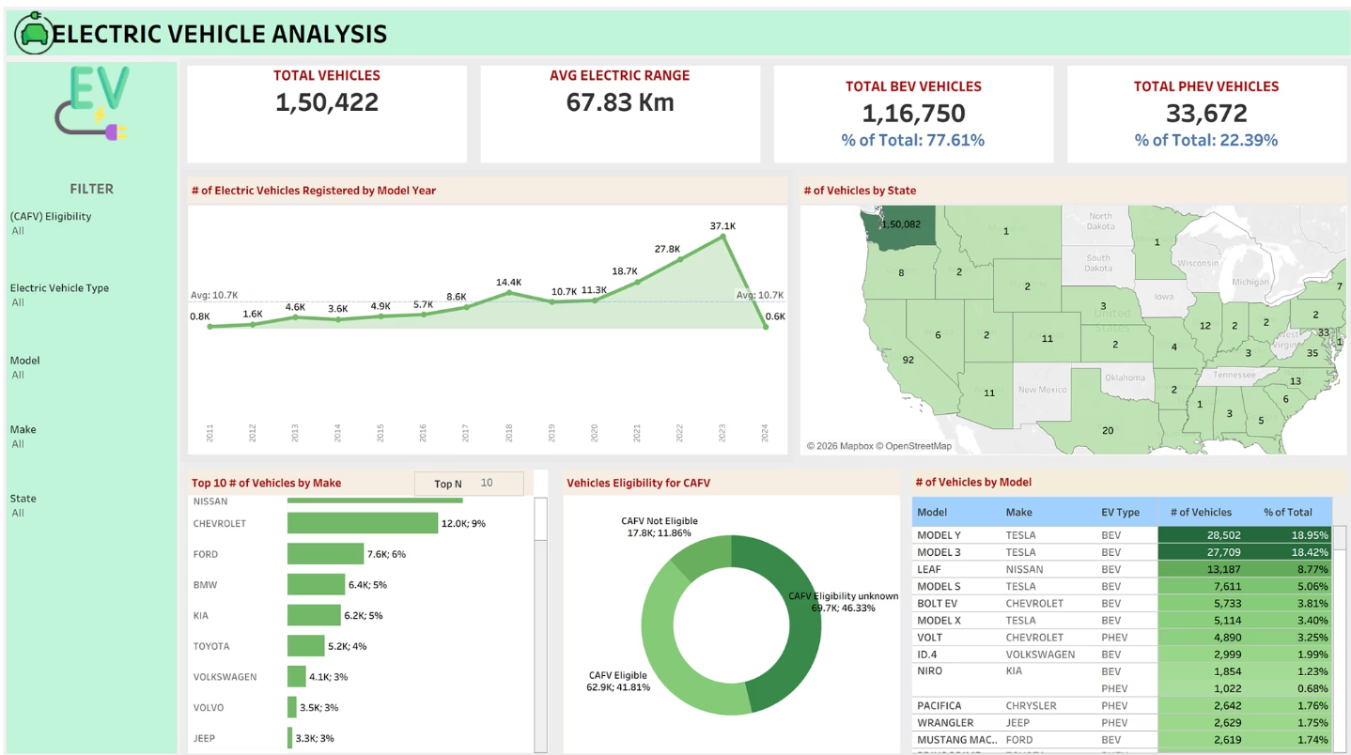
Dataset Overview
This comprehensive dashboard consolidates electric vehicle data spanning multiple dimensions including Battery Electric Vehicles (BEVs) and Plug-in Hybrid Electric Vehicles (PHEVs). The analysis covers temporal trends across model years, geographic distribution across states, and market segmentation by manufacturer and vehicle models.
Our data-driven approach provides actionable insights into the rapidly evolving EV landscape, enabling stakeholders to understand adoption patterns and make informed strategic decisions.

Slide 5
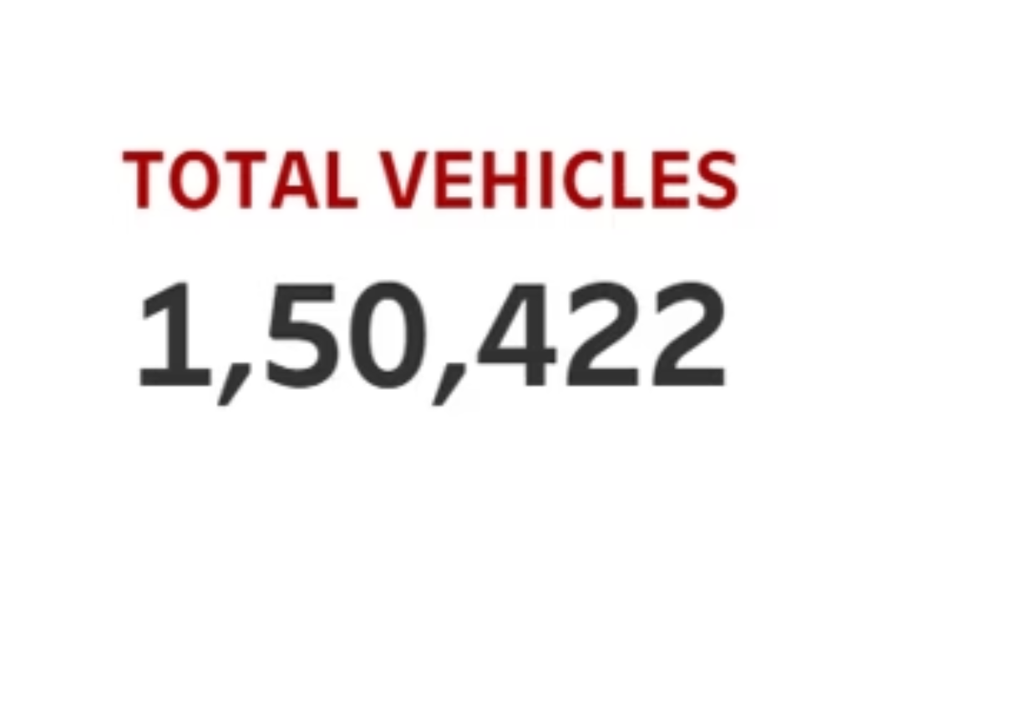
Total Electric Vehicles
150,422 EVs
The dataset encompasses a total of 150,422 registered electric vehicles, representing a substantial and growing segment of the automotive market. This figure reflects the cumulative impact of consumer adoption, policy initiatives, and technological advancement over the past decade.
This baseline metric serves as the foundation for understanding market penetration and future growth trajectories.

Slide 6
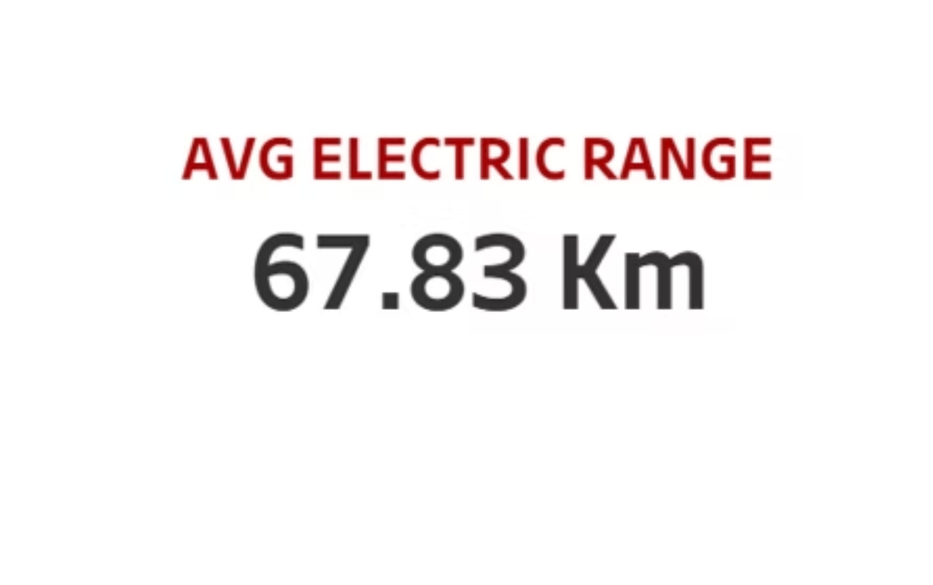
Average Electric Range
67.83
Average Range (km)
Current battery efficiency benchmark
The average electric range of 67.83 kilometers demonstrates current battery technology maturity and efficiency standards across the market. This metric reflects the balance between battery capacity, vehicle weight, and cost considerations.
Range remains a critical factor in consumer purchasing decisions and continues to improve with advancing battery chemistry and energy density innovations.

Slide 7
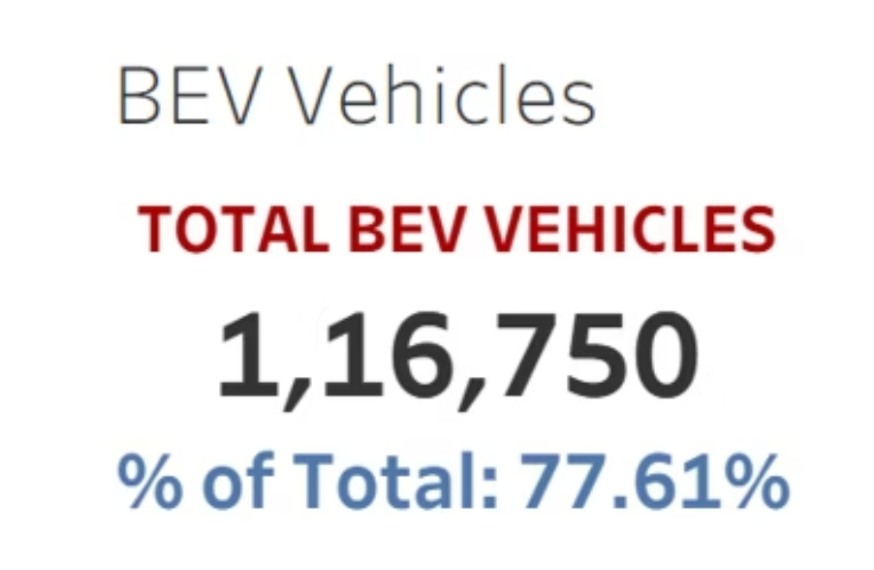

BEV FOCUS
Battery Electric Vehicles (BEV)
Market Leadership
Battery Electric Vehicles represent the dominant force in the EV market with 116,750 registered units, accounting for an impressive 77.61% of total electric vehicle adoption.
This clear preference for fully electric vehicles over hybrid alternatives signals strong consumer confidence in pure electric technology, supported by expanding charging infrastructure and improving range capabilities.
77.61%
BEV Market Share

Slide 8
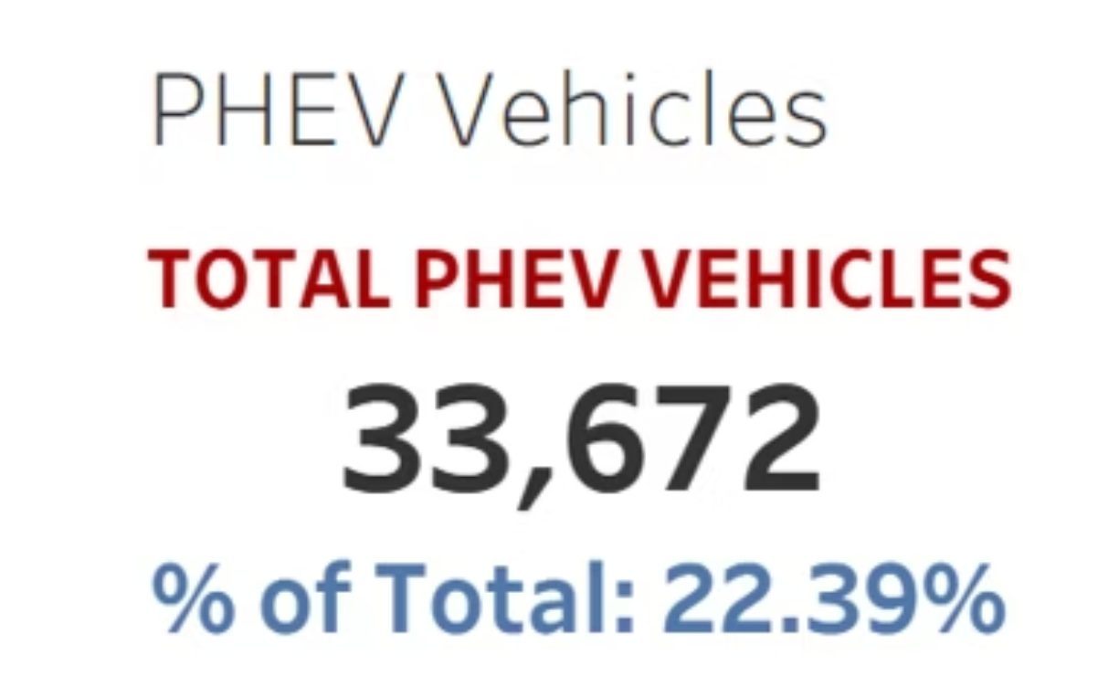
PHEV FOCUS
Plug-in Hybrid Electric Vehicles (PHEV)
Transitional Technology
Plug-in Hybrid Electric Vehicles comprise 33,672 units, representing 22.39% of the total EV market. PHEVs serve as a transitional technology, offering the flexibility of both electric and gasoline power.
This segment appeals to consumers with range anxiety concerns or limited charging access, providing a stepping stone toward full electrification while maintaining conventional vehicle versatility.
22.39%
PHEV Market Share

Slide 9
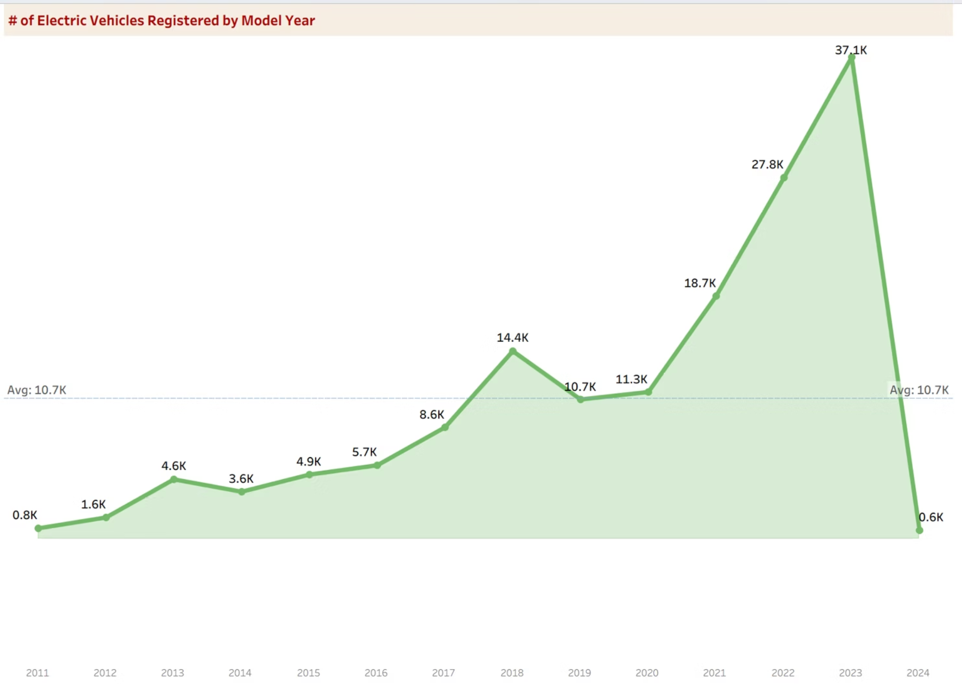
EV Growth by Model Year
This comprehensive line chart illustrates the dramatic acceleration in electric vehicle registrations, with particularly explosive growth observed post-2018, marking a pivotal inflection point in mainstream adoption.

Slide 10

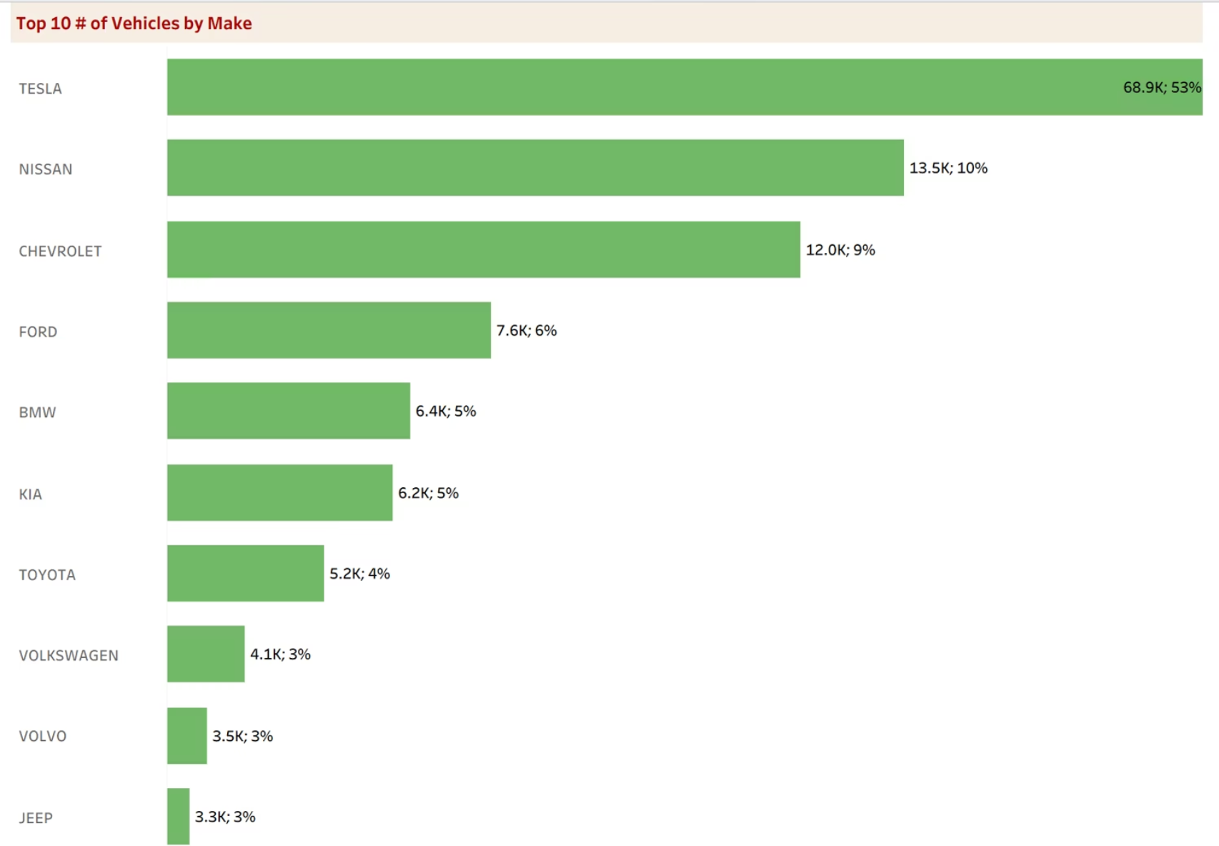
GEOGRAPHY
Geographical Distribution of EVs
The geographic heat map reveals significant concentration of electric vehicle adoption in specific regions, with notable clustering in urbanized metropolitan areas and states with progressive environmental policies.
This distribution pattern reflects the combined influence of charging infrastructure density, state-level incentive programs, environmental awareness, and demographic factors including income levels and education.

Slide 11
State-Level Insights
01
02
Strong Incentive Programs
Charging Infrastructure
States offering substantial purchase rebates, tax exemptions, and utility rate programs demonstrate adoption rates 3-5x higher than national average
Regions with dense public charging networks and streamlined permitting for home installations show sustained growth in registrations
03
Policy Leadership
States with zero-emission vehicle mandates and ambitious climate goals create market certainty that drives both supply and demand

Slide 12
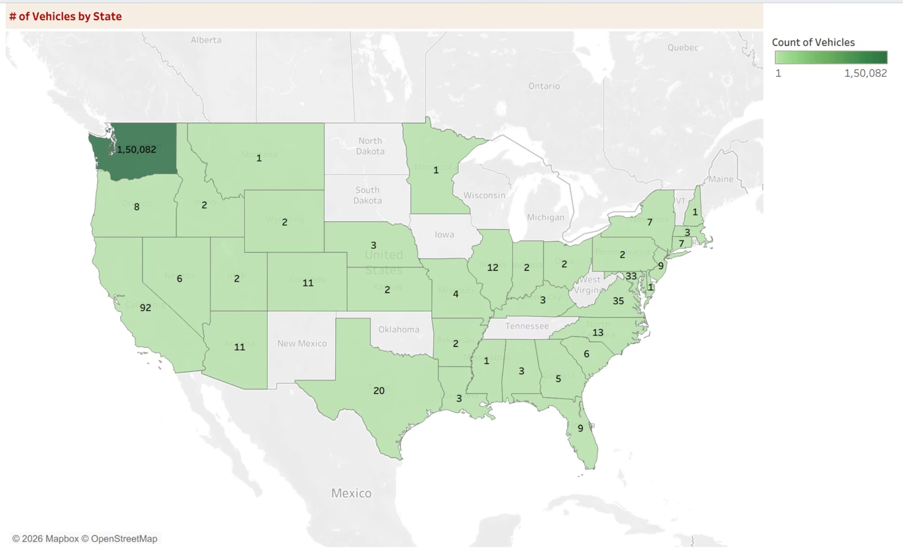
Top 10 EV Manufacturers
Tesla leads the market with commanding dominance, followed by established players like Nissan and Chevrolet. This hierarchy reflects strong brand loyalty, technological innovation, and consumer confidence in performance and charging infrastructure.

Slide 13
Manufacturer Market Share
Tesla's Dominance
Tesla's overwhelming market share reflects more than just product quality—it represents a comprehensive ecosystem advantage. From Supercharger networks to over-the-air updates and brand cachet, Tesla has created a vertically integrated experience that competitors struggle to match.
Over 50% market share demonstrates unparalleled consumer preference and product leadership
This dominance indicates strong consumer confidence in Tesla's technology, range capabilities, and long-term viability as the EV market continues to mature and expand.

Slide 14
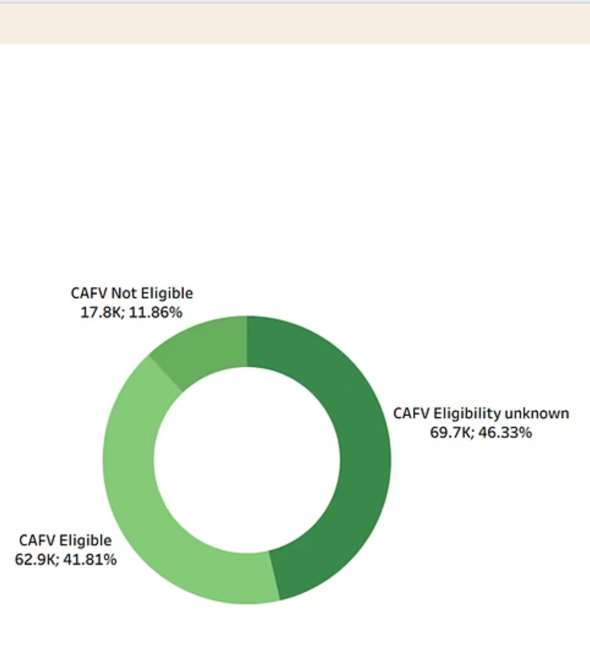
CAFV Eligibility Distribution
Clean Alternative Fuel Vehicle (CAFV) eligibility analysis reveals critical insights into how government incentives and regulatory frameworks influence EV adoption patterns across different vehicle segments and price points.
Policy Impact
Consumer Behavior
Incentives drive purchase decisions and accelerate market penetration
Eligibility status correlates strongly with adoption rates
Market Dynamics
Understanding eligibility patterns helps predict future trends

Slide 15
Impact of CAFV Incentives
Eligible Vehicles
Unknown Status
Adoption Driver
A significant portion of the EV fleet qualifies for federal and state tax credits, making electric vehicles more financially accessible to mainstream consumers.
Many vehicles have undetermined eligibility status, indicating opportunities for improved data collection and consumer education about available incentives.
CAFV incentives play a crucial role in accelerating EV adoption by reducing the total cost of ownership and bridging the price gap with traditional vehicles.

Slide 16
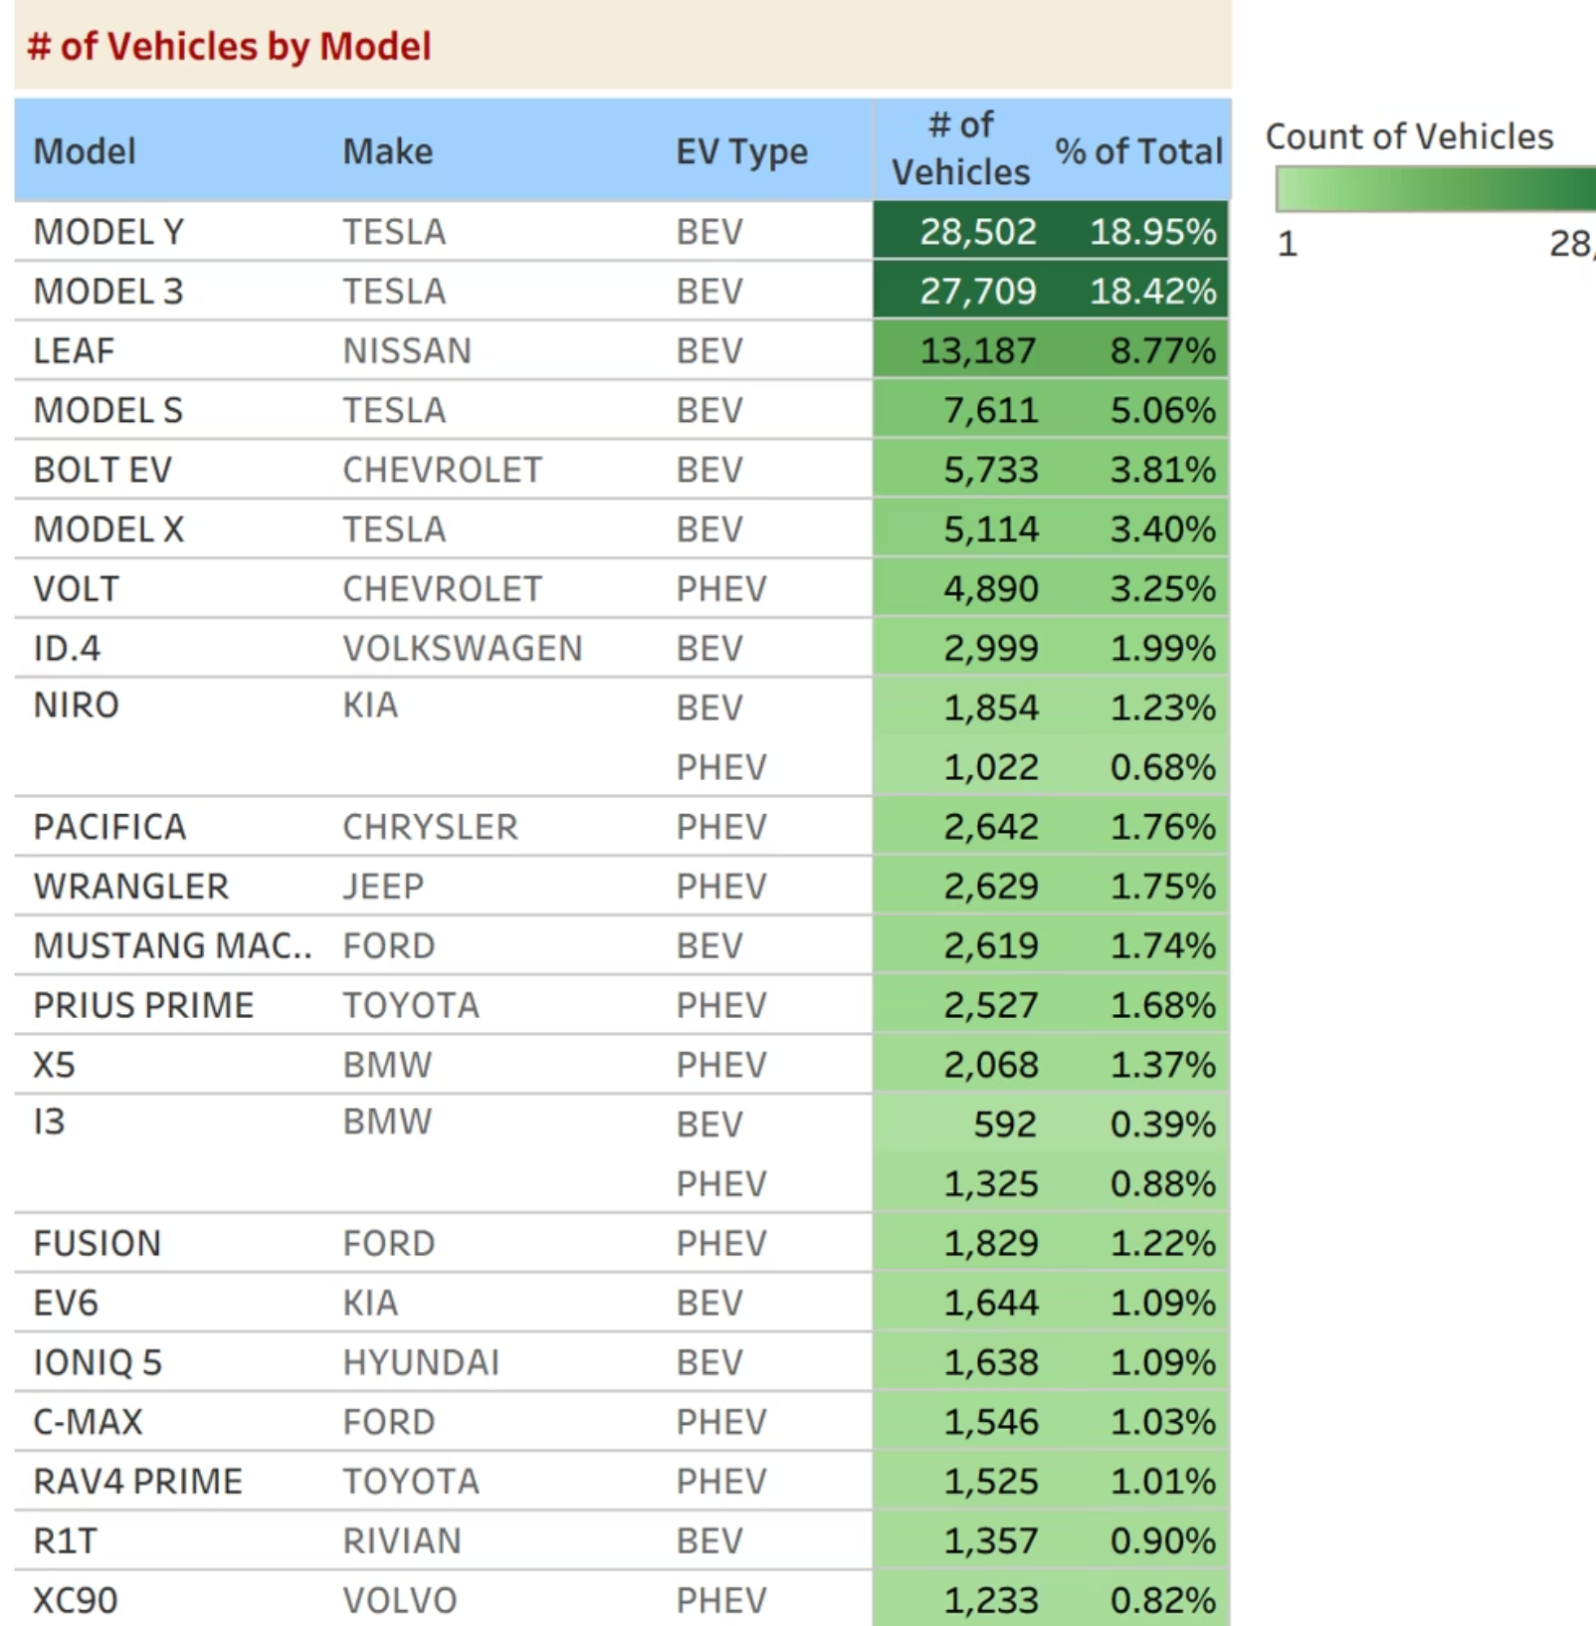
Top EV Models
These models dominate sales rankings due to proven performance, industry-leading range, extensive Supercharger access, and strong brand reputation for innovation and reliability.

Slide 17
Overall Dashboard

Slide 18
KEY FINDINGS
Market Insights & Consumer Preferences
1
2
3
BEV Market Dominance
Tesla's Leadership
Rapid Growth Trajectory
Battery Electric Vehicles represent the overwhelming majority of sales, signaling consumer preference for fully electric over hybrid solutions
Tesla maintains commanding leads in both manufacturer rankings and individual model popularity through ecosystem advantages
Year-over-year adoption continues accelerating as technology improves, prices decline, and charging infrastructure expands
Consumer Model Preferences
Purchase decisions are driven by multiple interconnected factors: maximum driving range to reduce charging anxiety, established brand reliability and resale value, comprehensive charging ecosystem support, and total cost of ownership including incentives. These priorities reflect a maturing market where consumers balance practical needs with environmental values.

Slide 19
Summary
150K
77.6%
Transforming Mobility
The electric vehicle revolution is accelerating, driven by technological advancement, supportive policy frameworks, and evolving consumer demand.
Total Vehicles
BEV Share
Market size with strong post-2018 growth momentum
Clear consumer shift toward fully electric mobility
Tesla's Ecosystem Advantage
Geographic Concentration
Incentive Influence
CAFV eligibility and financial programs significantly impact purchasing decisions, making policy a critical adoption lever
Leading manufacturer and model rankings demonstrate the power of integrated charging networks and brand loyalty
Adoption clusters in regions with robust policy support and developed charging infrastructure highlight the importance of enabling conditions

